Slide 1
Jie Dong’s Game Projects
Wingman
TankWar

Slide 2
2 major challenges
For all gaming components
inheritance – common behavior
behavior V.S. view
separate responsibilities
Managing resources
image, animation and sound
game rules - e.g. enemies, reward

Slide 3
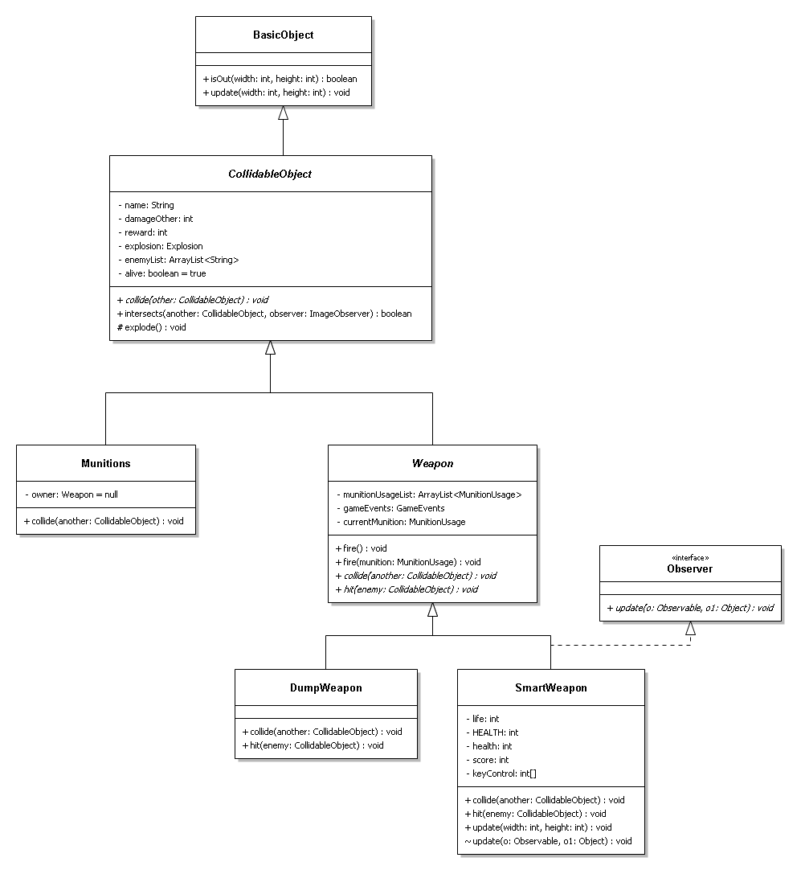

Slide 4
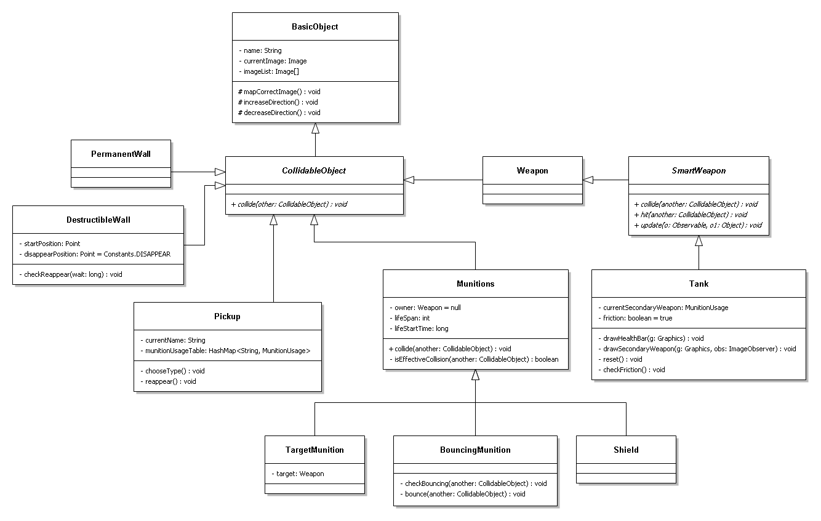

Slide 5
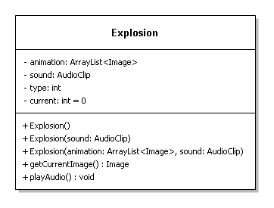

Slide 6
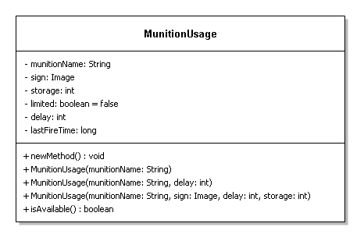

Slide 7
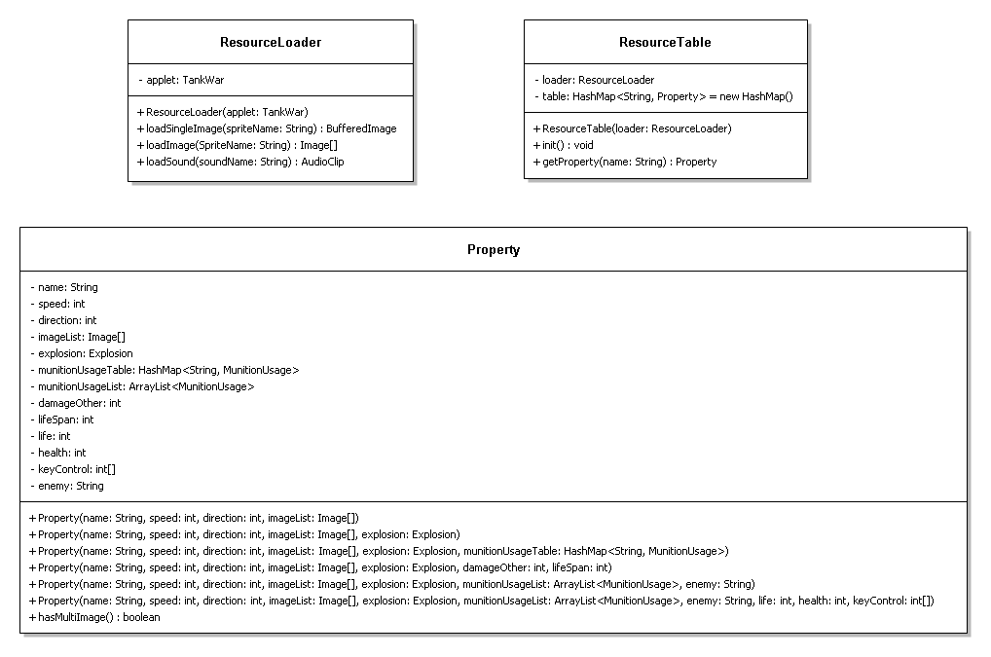

Slide 8
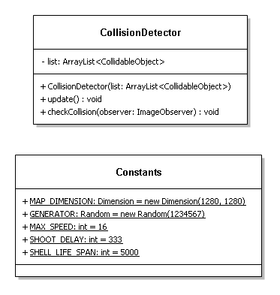

Slide 9
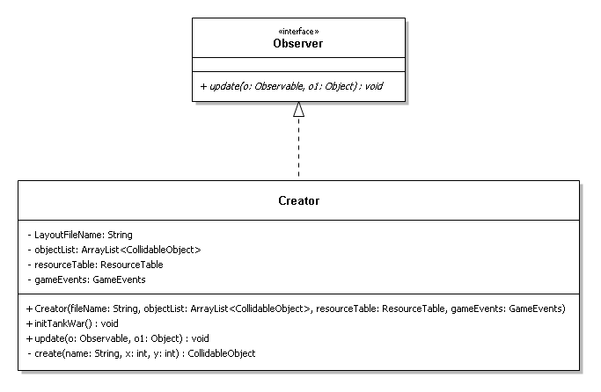

Slide 10
Summary
1. Separate responsibilities:
SmartWeapon – abstract V.S. concrete
Tank → ResourceLoader + ResourceTable +
CollisionDetector + Creator
2. Observer & Observable – loosely coupled
e.g. way to create bullets
3. GUI – separate view from model
e.g. EnemyPlaneDown & EnemyPlaneUp
4. Group data into classes
e.g. Explosion, Property

